Slide 1
PageSpeed Analytics Application
Capstone Presentation
Lillian Arguelles

Slide 2


Page Speed Insights
Announcement in January 17th on Webmasters Blog

Slide 3
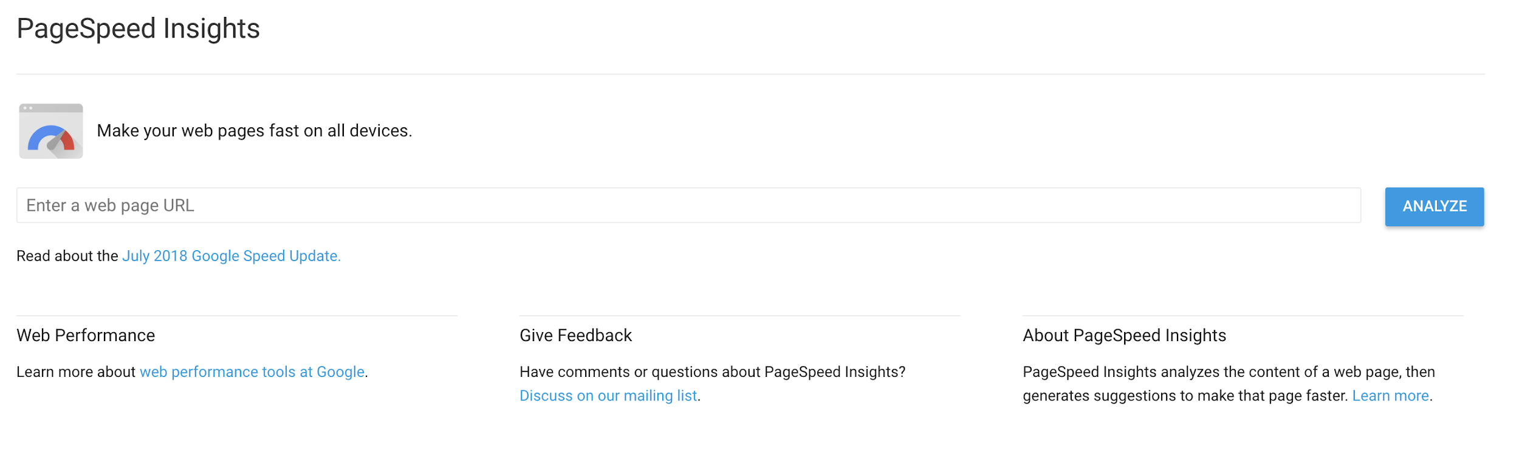
Page Speed Insights - Website Example for Desktop

Slide 4
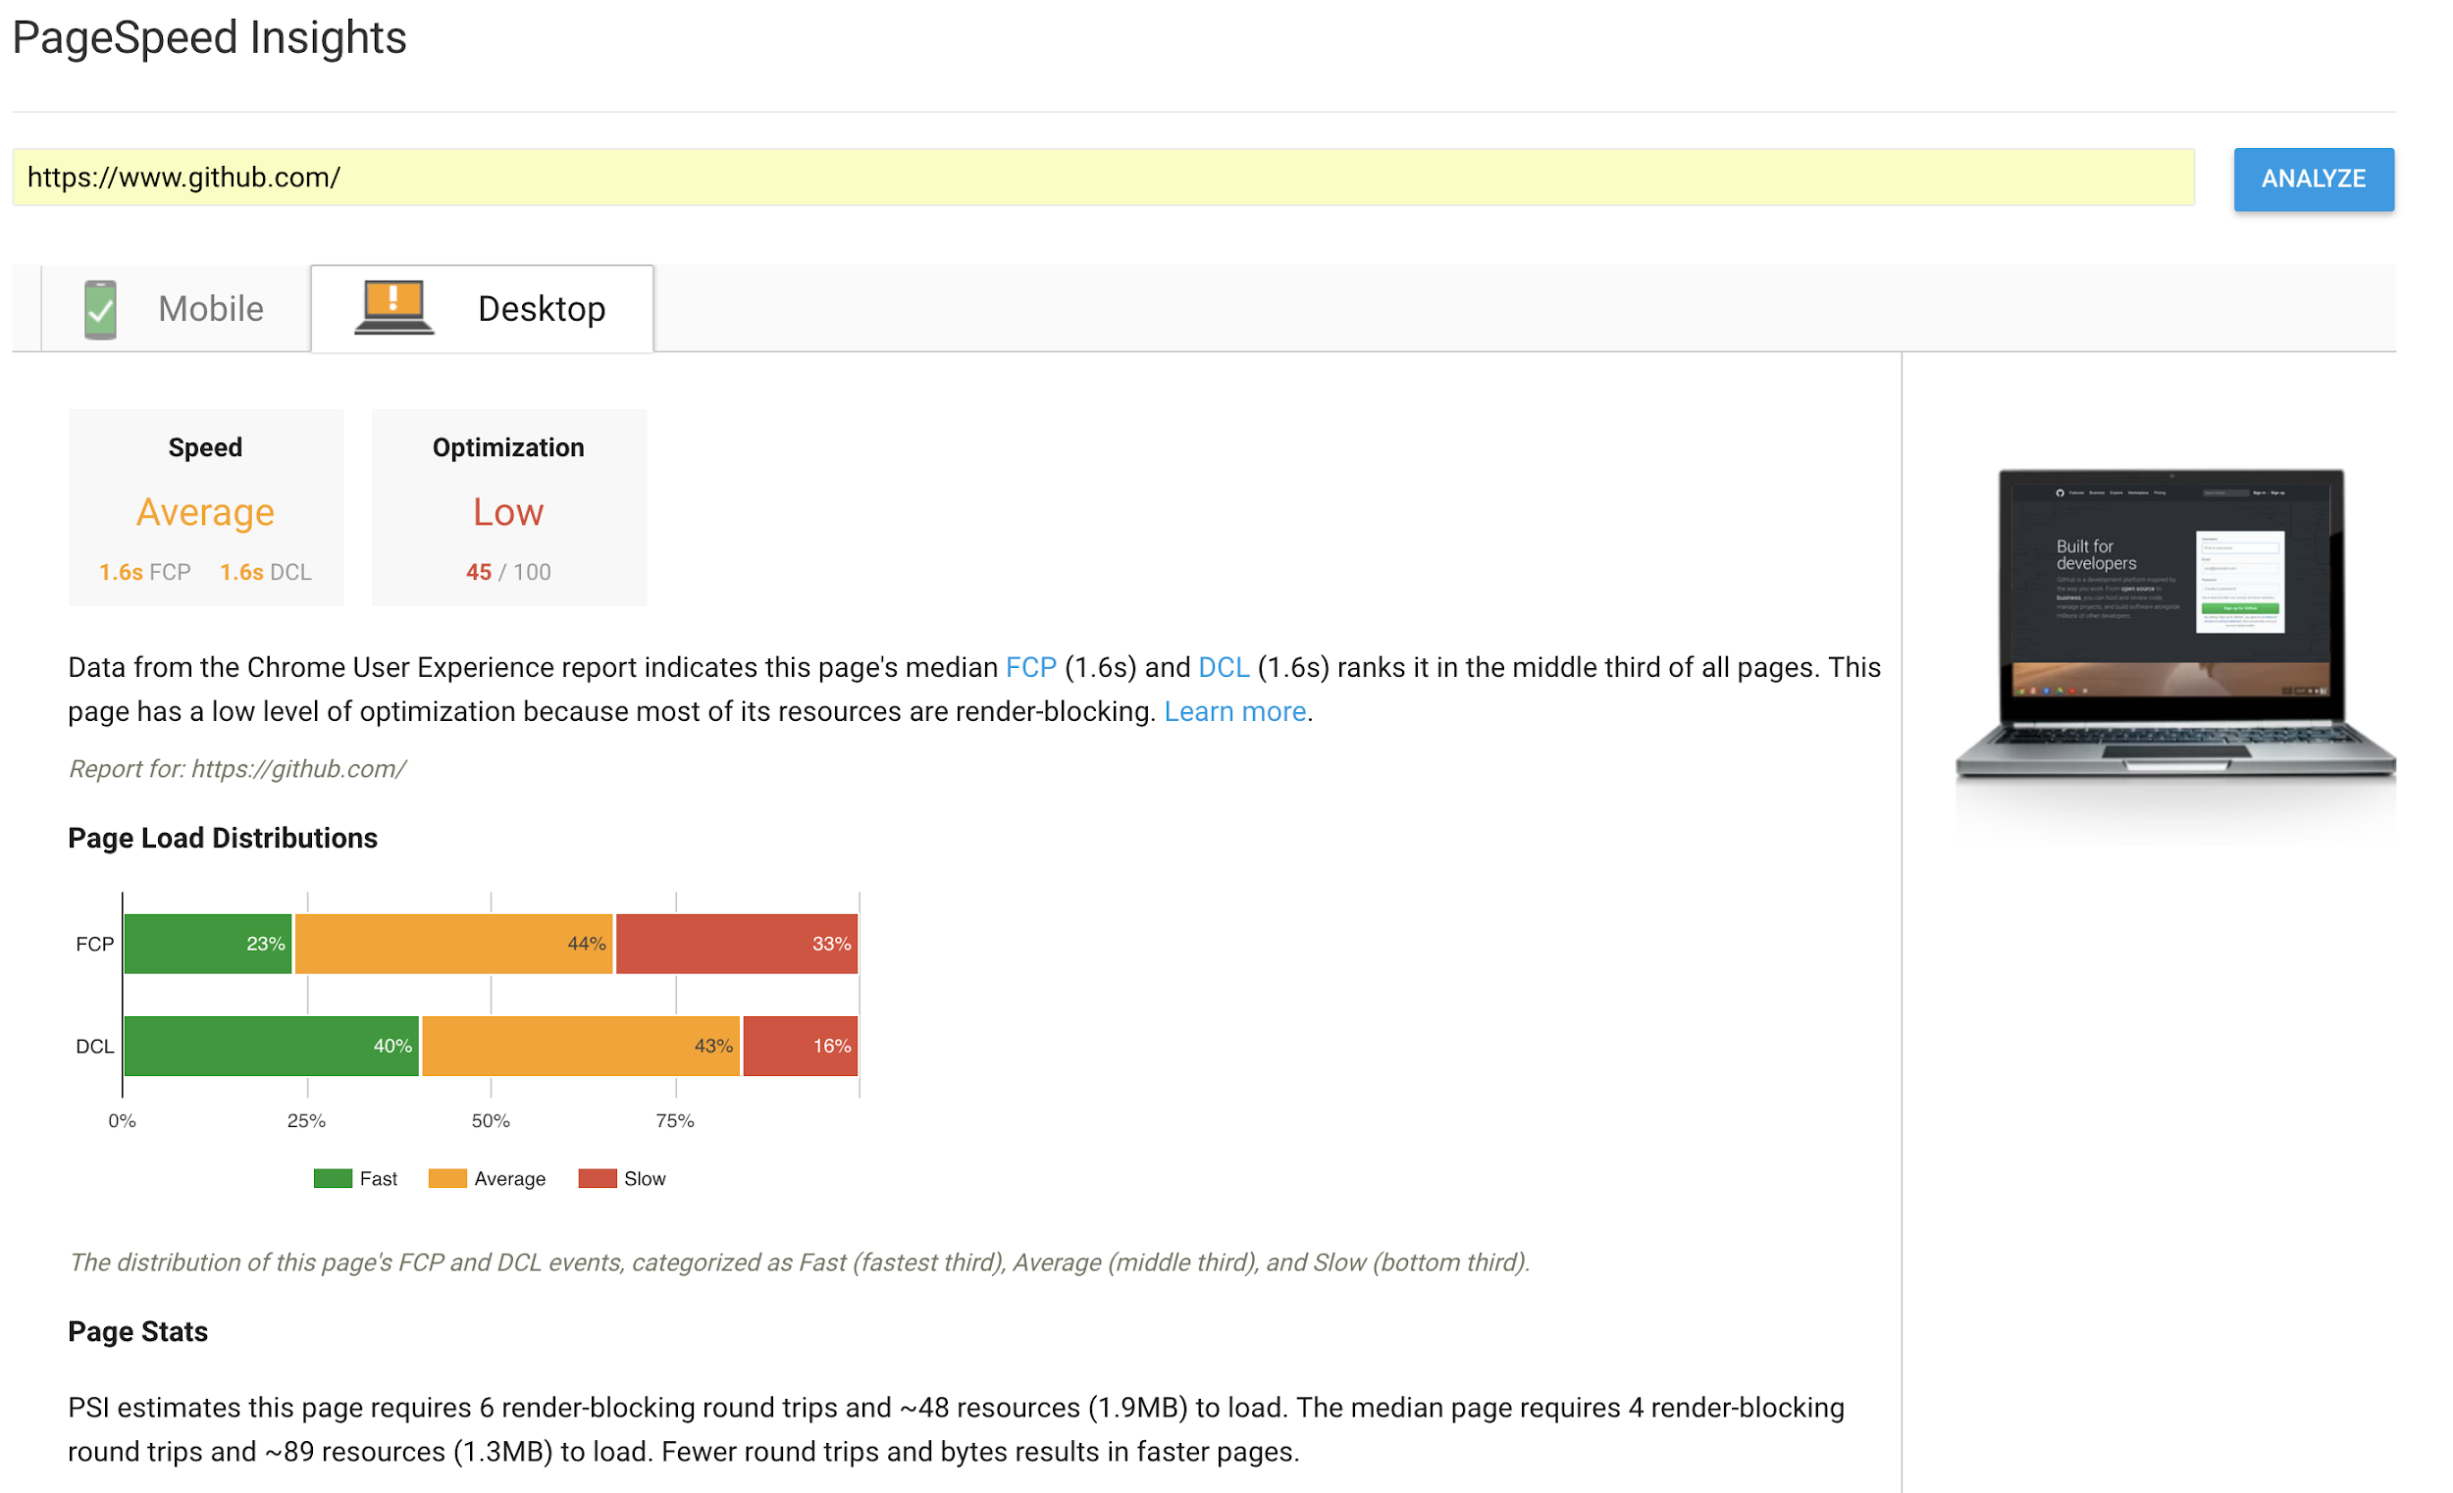
Page Speed Insights - Website Example for Desktop

Slide 5
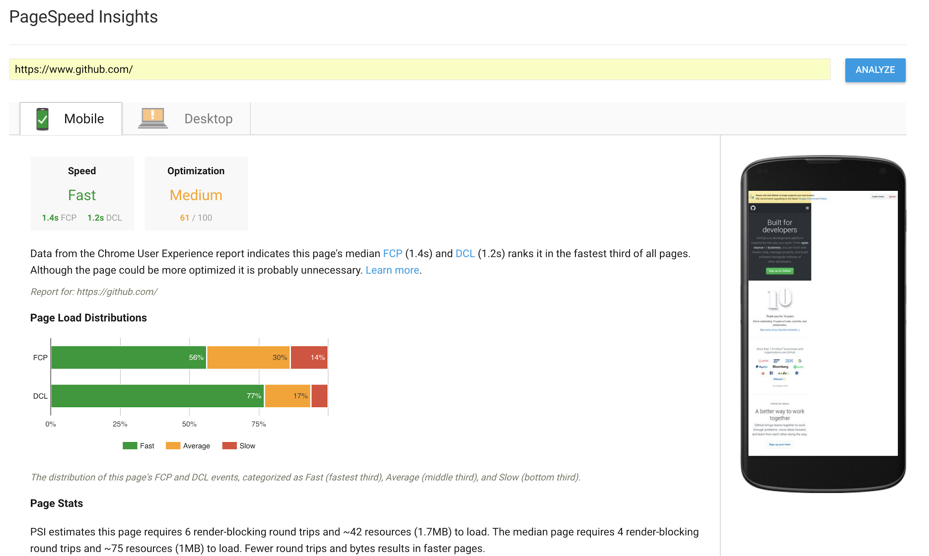
Page Speed Insights - Website Example for Mobile

Slide 6
Page Speed Insights API
Page Speed Insights API v4
Package: Google.Apis.Pagespeedonline.v4
Google.Apis.Pagespeedonline.v4
Google.Apis.Pagespeedonline.v4.Data.PagespeedApiPagespeedResponseV4
PagespeedonlineService
BaseClientService
PagespeedapiResource
RunpagespeedRequest

Slide 7
Classes and Interfaces
12 Classes
5 User Interface GUI Forms

Slide 8
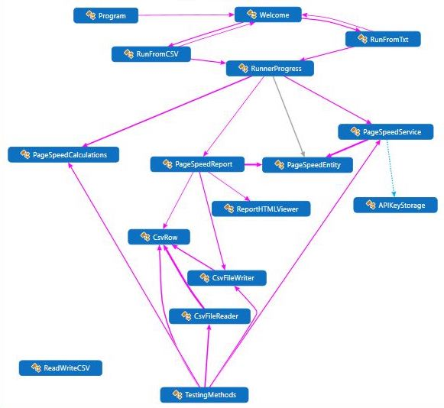
Structure

Slide 9
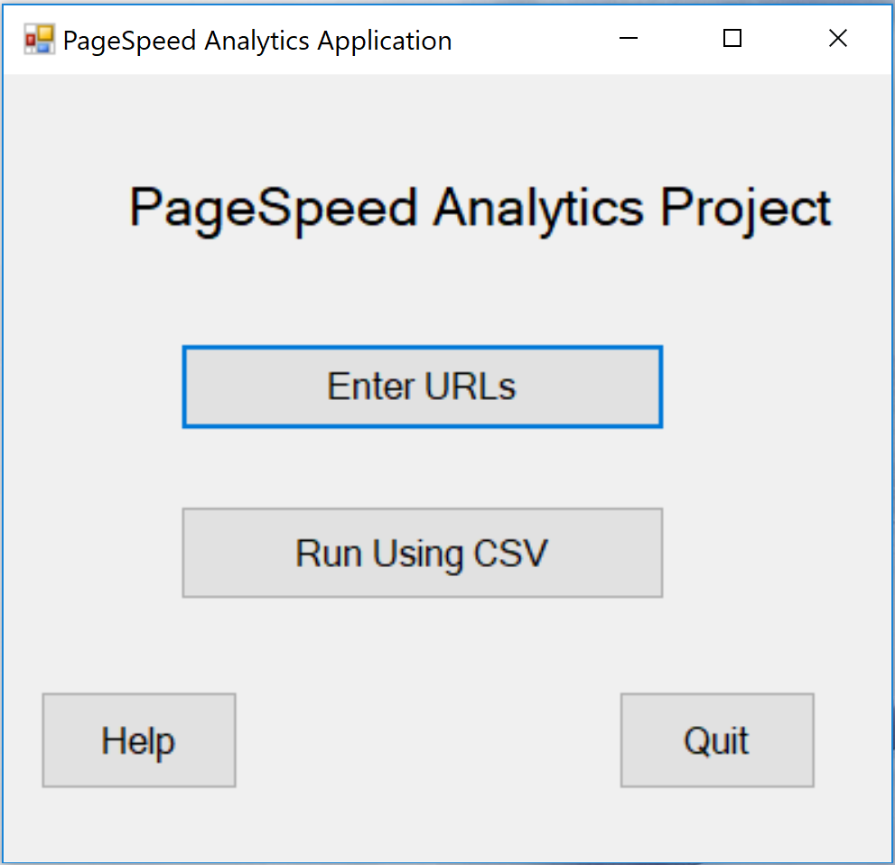
Welcome GUI

Slide 10
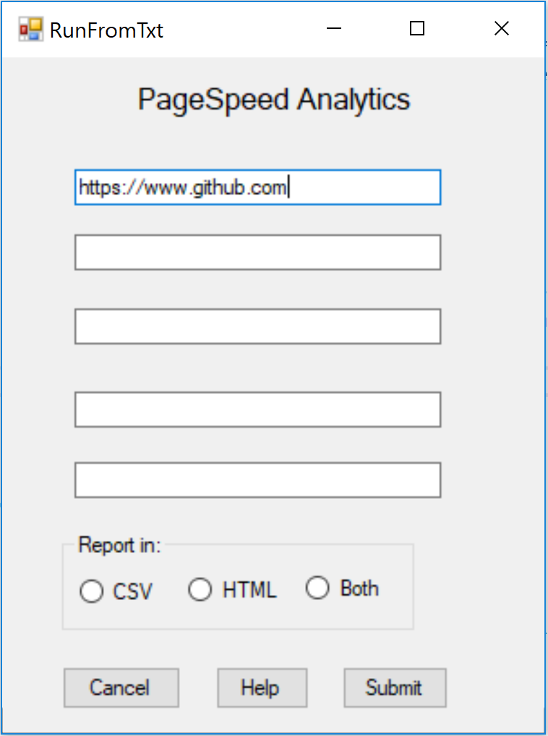
RunFromTxt GUI

Slide 11
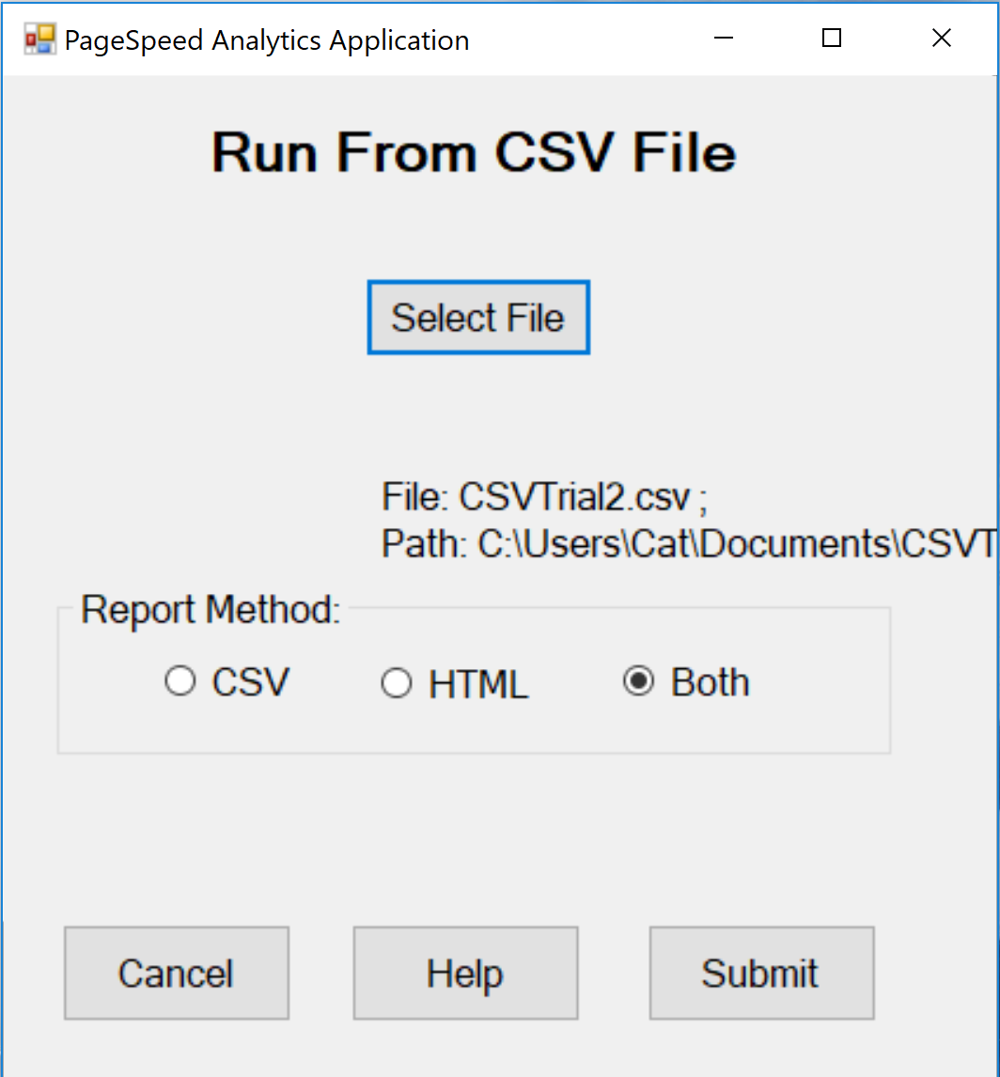
RunFromCSV GUI

Slide 12
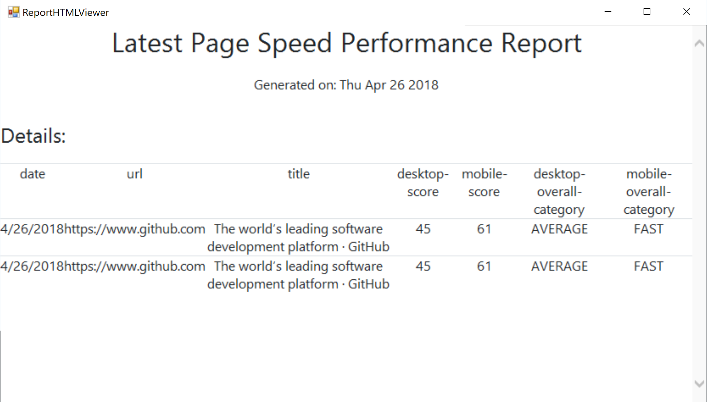
ReportHTMLViewer GUI

Slide 13
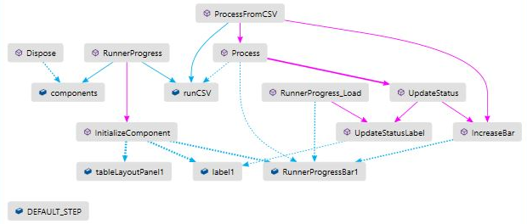
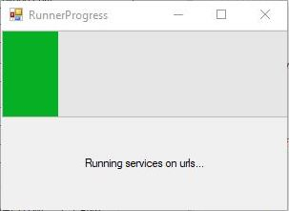
RunnerProgress GUI

Slide 14
Other Classes
Program
APIKeyStorage
PageSpeedCalculations
PageSpeedEntity
PageSpeedReport
PageSpeedService
ReadWriteCSV

